Slide 1
DESIGN AND ANALYSIS OF ALGORITHMS
GRAPH ALGORITHMS
Submitted by-
Vikas Paliwal
181210058

Slide 2
Table of contents
Breadth-First Search Algorithm
Depth-First Search Algorithm
Minimum spanning tree
Kruskal’s Algorithm
Prim’s Algorithm
Single-Source shortest path(Dijkstra’s Algorithm)
All pair shortest path(Floyd Warshal Algorithm)

Slide 3
Breadth-First Search(BFS)
BFS is a traversing algorithm where we start traversing from a selected node (source or starting node) and traverse the graph layerwise thus exploring the neighbor nodes (nodes which are directly connected to source node). After traversing the visited nodes we go for the next nodes .
A graph can contain cycles, which may bring us to the same node again while traversing the graph. To avoid processing of same node again, we can use a Boolean array which marks the node after it is processed. While visiting the nodes in the layer of a graph, visited nodes are store them in a manner such that it can traverse the corresponding child nodes in a similar order.
We use a queue to store the node and mark it as ‘Visited’ until all its neighbors are marked.

Slide 4
Pseudocode
BFS (G, s)
let Q be queue.
Q.enqueue( s )
mark s as visited.
while ( Q is not empty)
v = Q.dequeue( )
for all neighbors w of v in Graph G
if w is not visited
Q.enqueue( w )
mark w as visited.

Slide 5
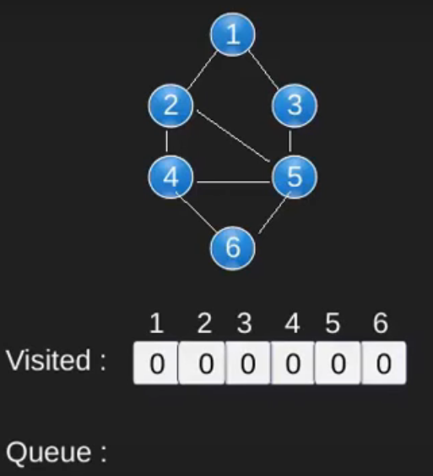
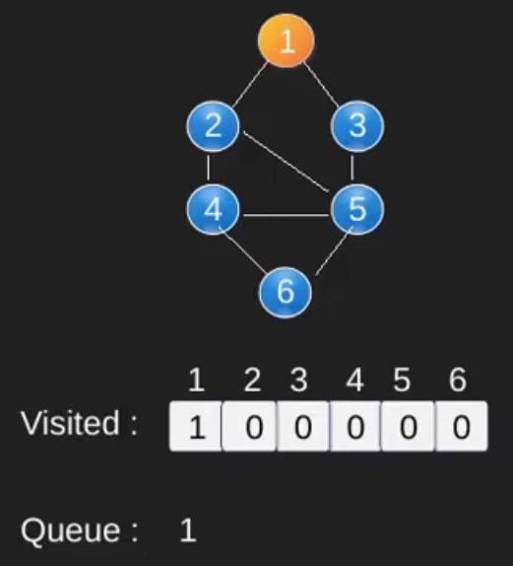
Illustartion

Slide 6
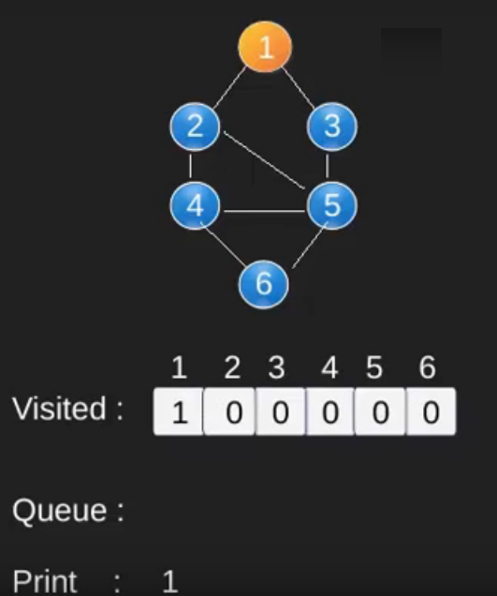
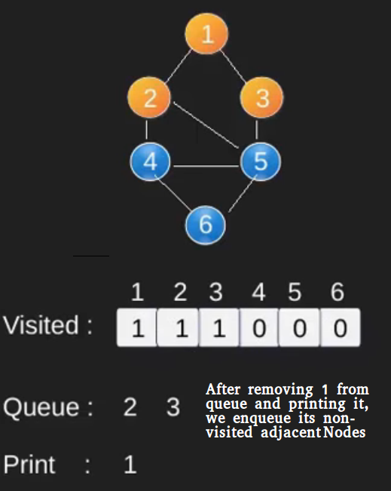

Slide 7
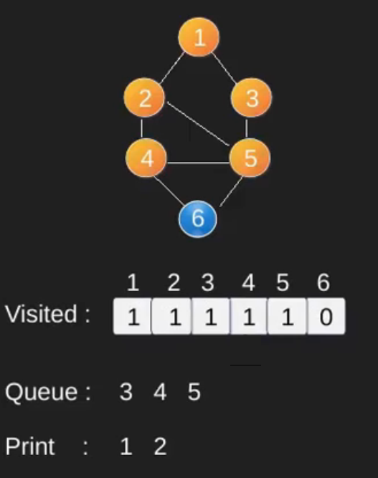
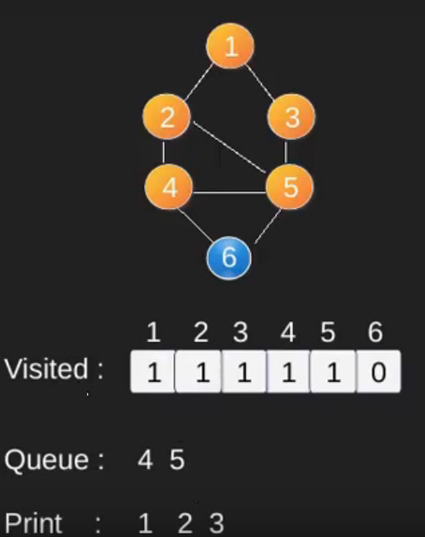

Slide 8
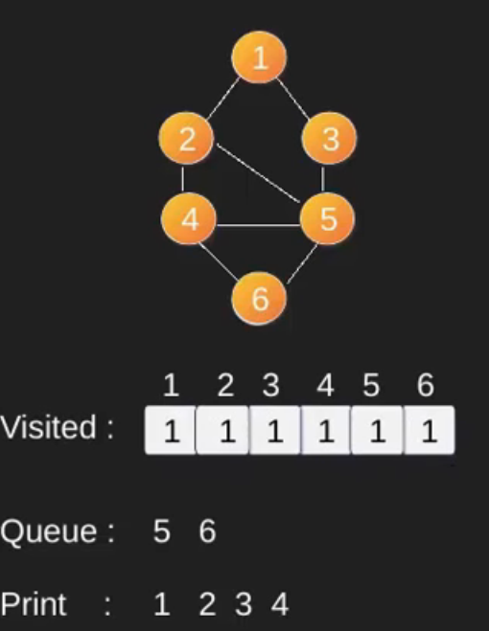
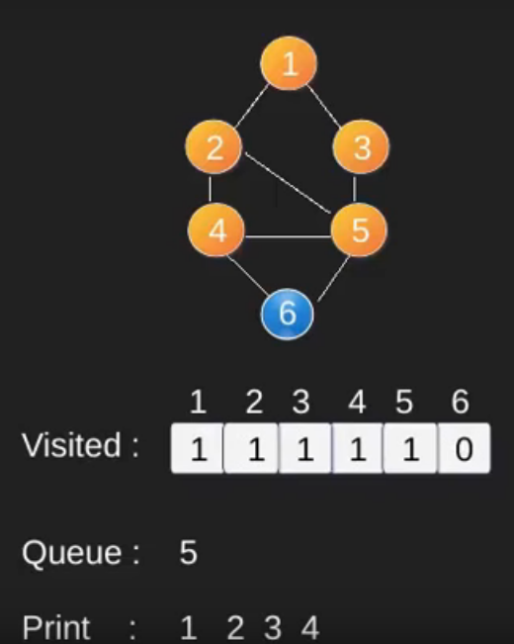

Slide 9
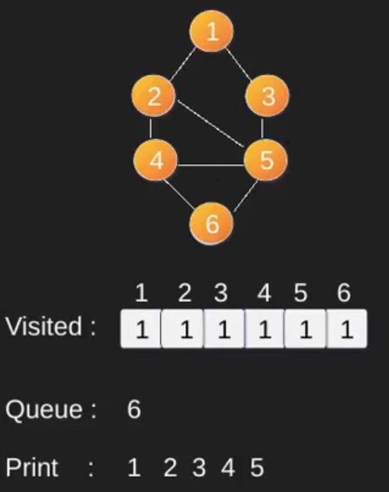
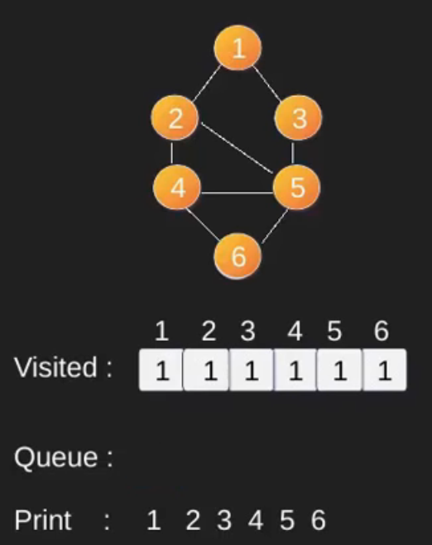

Slide 10
Depth-First Search(DFS)
Depth first traversal or Depth first Search is a recursive algorithm for searching all the vertices of a graph or tree data structure.
A standard DFS implementation puts each vertex of the graph into one of two categories:
1). Visited
2). Not Visited
The DFS algorithm works as follows:
Start by putting any one of the graph's vertices on top of a stack.
Take the top item of the stack and add it to the visited list.
Create a list of that vertex's adjacent nodes. Add the ones which aren't in the visited list to the top of stack.
Keep repeating steps 2 and 3 until the stack is empty.

Slide 11
Pseudocode:
DFS-iterative (G, s):
let S be stack
S.push( s )
mark s as visited.
while ( S is not empty):
v = S.top( )
S.pop( )
for all neighbours w of v in Graph G:
if w is not visited :
S.push( w )
mark w as visited
DFS-recursive(G, s):
mark s as visited
for all neighbours w of s in Graph G:
if w is not visited:
DFS-recursive(G, w)

Slide 12
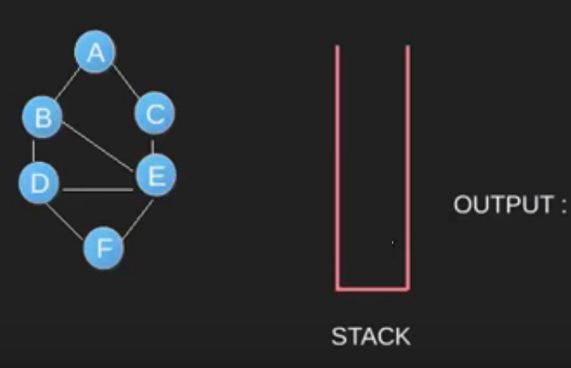
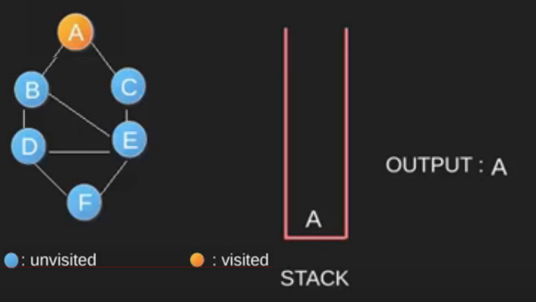
Illustration

Slide 13
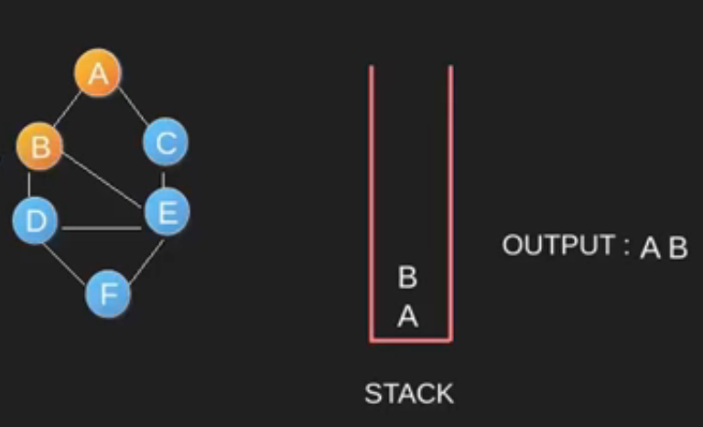
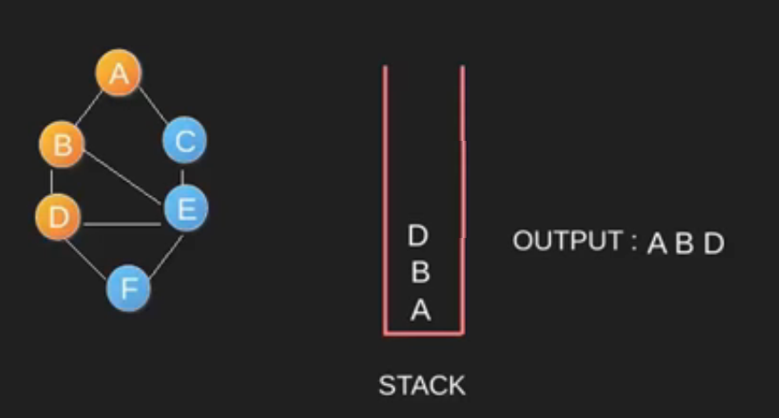

Slide 14
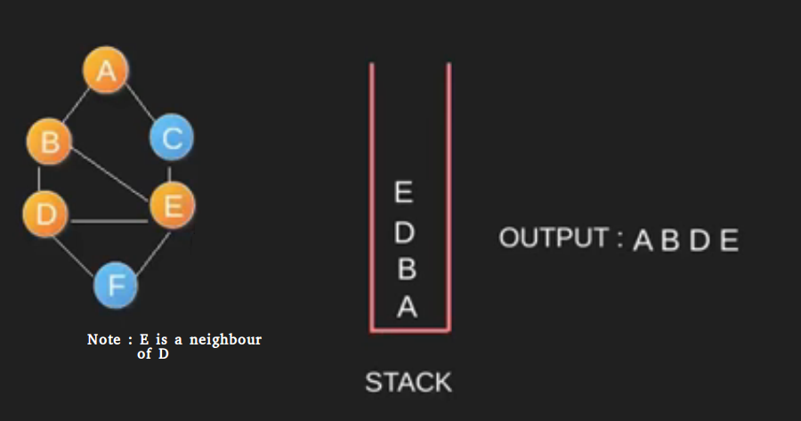
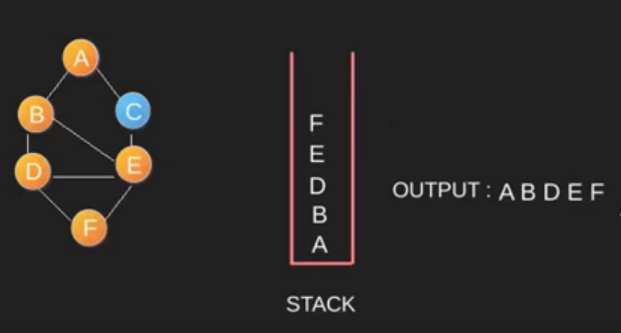

Slide 15
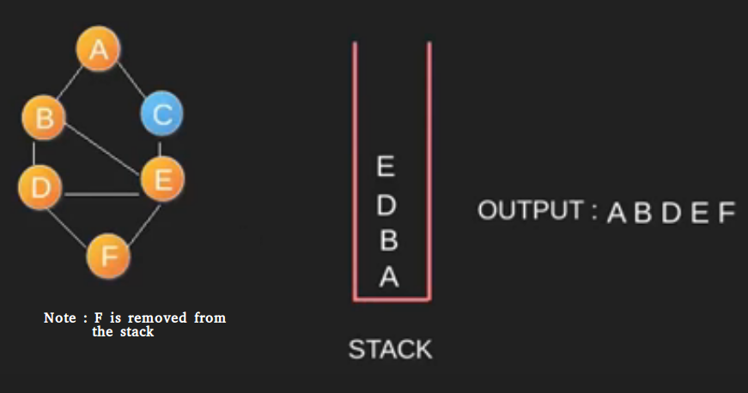
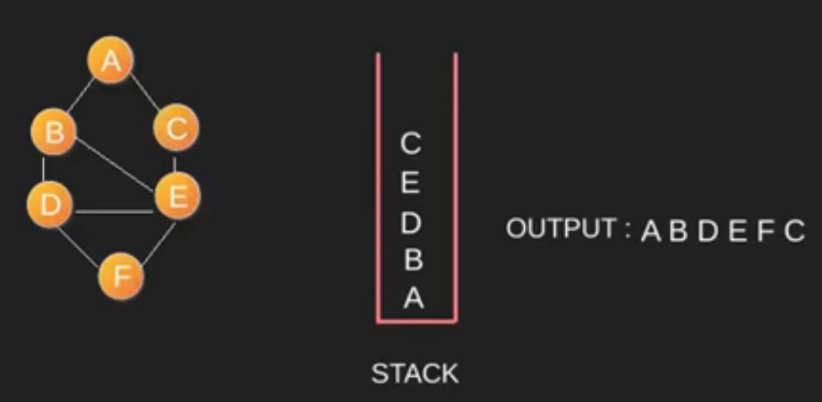

Slide 16
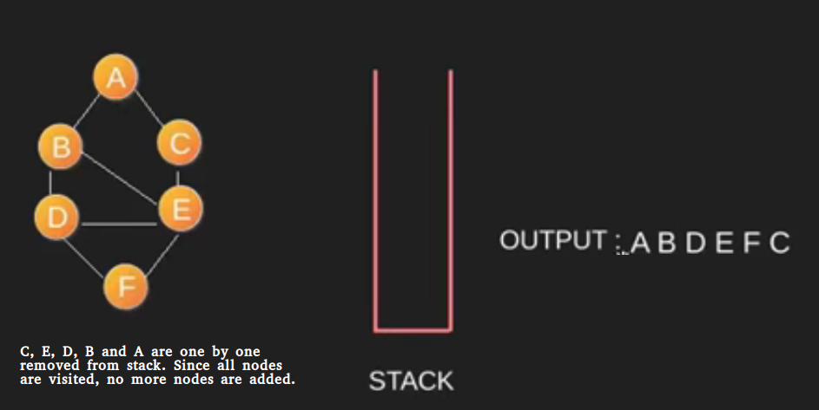

Slide 17
Minimum Spanning Tree
What is a Spanning Tree?
Given an undirected and connected graph G=(V,E), a spanning tree of the graph is a tree that spans G(that is, it includes every vertex of G) and is a subset of G(every edge in the tree belongs to G).
Minimum Spanning Tree:
The cost of the spanning tree is the sum of the weights of all the edges in the tree. There can be many spanning trees. Minimum spanning tree is the spanning tree where the cost is minimum among all the spanning trees. There also can be many minimum spanning trees.
Minimum spanning tree has direct application in the design of networks. It is used in algorithms approximating the travelling salesman problem, multi-terminal minimum cut problem and minimum-cost weighted perfect matching.

Slide 18
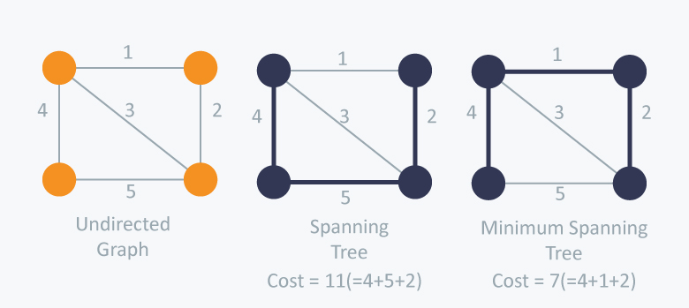

Slide 19
Algorithms for finding Minimum Spanning Tree
There are two famous algorithms for finding the Minimum Spanning Tree:
Kruskal’s Algorithm
Prim’s Algorithm

Slide 20
Kruskal's Algorithm
Kruskal’s Algorithm builds the spanning tree by adding edges one by one into a growing spanning tree. Kruskal's algorithm follows greedy approach as in each iteration it finds an edge which has least weight and add it to the growing spanning tree.

Slide 21
Algorithm Steps:
Sort the graph edges with respect to their weights.
Start adding edges to the MST from the edge with the smallest weight until the edge of the largest weight.
Only add edges which doesn't form a cycle , edges which connect only disconnected components.

Slide 22
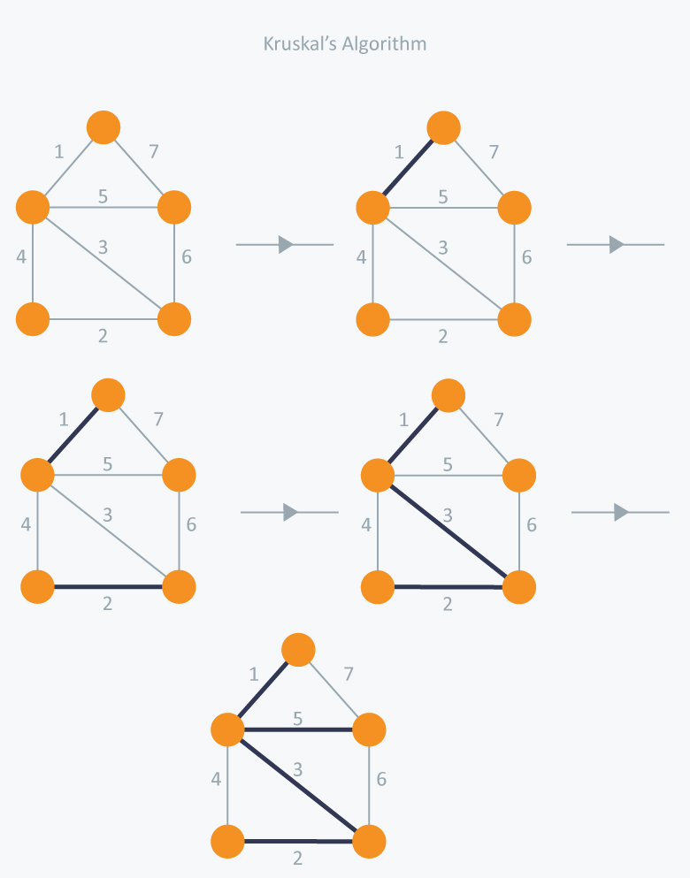
Example

Slide 23
Prim's Algorithm
Prim’s Algorithm also use Greedy approach to find the minimum spanning tree. In Prim’s Algorithm we grow the spanning tree from a starting position. Unlike an edge in Kruskal's, we add vertex to the growing spanning tree in Prim's.

Slide 24
Algorithm Steps:
Maintain two disjoint sets of vertices. One containing vertices that are in the growing spanning tree and other that are not in the growing spanning tree.
Select the cheapest vertex that is connected to the growing spanning tree and is not in the growing spanning tree and add it into the growing spanning tree. This can be done using Priority Queues. Insert the vertices, that are connected to growing spanning tree, into the Priority Queue.
Check for cycles. To do that, mark the nodes which have been already selected and insert only those nodes in the Priority Queue that are not marked.

Slide 25
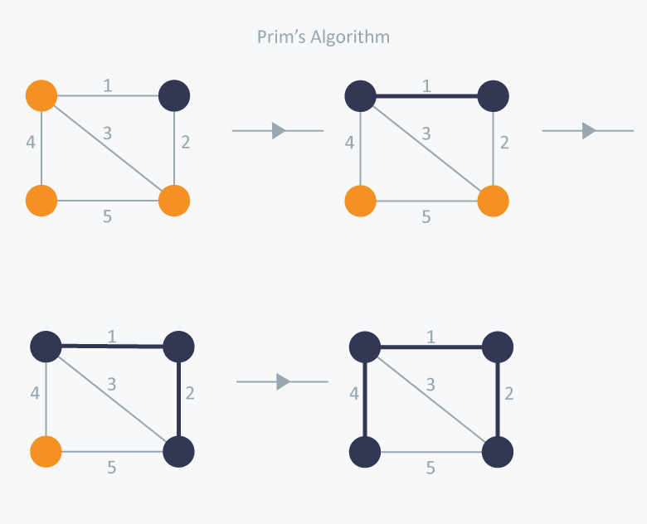
Example

Slide 26
Shortest Path Problems
In graph theory, the shortest path problem is the problem of finding a path between two vertices (or nodes) in a graph such that the sum of the weights of its constituent edges is minimized.
There are two categories of shortest path problems
Single-Source shortest path
All- pair shortest path

Slide 27
Single-Source shortest path problem
In single-source shortest path problem, we have to find shortest paths from a source vertex v to all other vertices in the graph.
The algorithm used to solve this problem is known as ‘Dijkstra’s Algorithm’.

Slide 28
Dijkstra's Algorithm
Dijkstra's algorithm has many variants but the most common one is to find the shortest paths from the source vertex to all other vertices in the graph.
Algorithm Steps:
Set all vertices distances = infinity except for the source vertex, set the source distance = 0.
Push the source vertex in a min-priority queue in the form (distance , vertex), as the comparison in the min-priority queue will be according to vertices distances.

Slide 29
Pop the vertex with the minimum distance from the priority queue (at first the popped vertex = source).
Update the distances of the connected vertices to the popped vertex in case of "current vertex distance + edge weight < next vertex distance", then push the vertex with the new distance to the priority queue.
If the popped vertex is visited before, just continue without using it.
Apply the same algorithm again until the priority queue is empty.

Slide 30
All pair shortest path
The all pair shortest path algorithm is also known as Floyd-Warshall algorithm is used to find all pair shortest path problem from a given weighted graph. As a result of this algorithm, it will generate a matrix, which will represent the minimum distance from any node to all other nodes in the graph.
The time complexity of this algorithm is O(V3), here V is the number of vertices in the graph

Slide 31
Algorithm :
Begin
for k := 0 to n, do
for i := 0 to n, do
for j := 0 to n, do
if cost[i,k] + cost[k,j] < cost[i,j], then
cost[i,j] := cost[i,k] + cost[k,j]
done
done
done
display the current cost matrix
End

